Slide 1
Build’an’Office add-in- using’modern JavaScript tools and techniques
Build an Office add-in using Angular -

Slide 2

Build an Office add-in using Angular-
Angular 101
Building add-ins with Angular
Side-loading and debugging
Overview of the sample

Slide 3

Angular 101
Angular is an open-source platform maintained by Google for front-end web development. It is based heavily on TypeScript and was a complete ground-up rewrite of AngularJS.
Angular is a completely different framework from AngularJS, but is often referred to as Angular 2 or Angular 4.
Angular can be developed with JavaScript, but all documentation and learning resources in TypeScript.
Google positioning Angular for developers to build applications that live across web, mobile, and desktop.
Notes:
The second client-side framework we will explore for Office add-ins is Angular. Angular is a wildly popular front-end framework open-sourced by Google. It is important to note that Angular is a completely different framework from AngularJS and was build new from the ground-up. Angular is often referred to as Angular 2 (the 2 being that is was after AngularJS) or Angular 4 (technically the most current Angular library is v4). Angular has a number of differences from AngularJS, one of the most notable is that Angular is based heavily on TypeScript, including the framework itself and all documentation/samples.

Slide 4

Angular 101 – Difference from AngularJS
Major differences
No concept of “scope” or controllers…uses component hierarchy
Uses [] for property binding and () for event binding
Much more modular (vs a few huge libraries)
TypeScript first
Better performance
Improved dependency injection and routing
Includes CLI for project templating and development
Better positioned for large project development
!=
Notes:
Again, Angular is not the the same or a derivative of AngularJS. Comparing the two, you will find Angular has no concept of a scope or controller as was foundational in AngularJS. Instead Angular leveraged a component hierarchy. In markup, you will find the attribute directives completely different…using [] brackets for property bindings and () parenthesis for event binding. Angular is much more modular that AngularJS, has better performance, improved dependency injection, and cleaner routing. Ultimately, it is much better positioned to deliver large complex development compared to AngularJS.

Slide 5
Angular 101 - Sample
<h2>{{title}}</h2>
<div>
<input type="text" #newItem
(keyup.enter)="add(newItem.value); newItem.value = '';" />
</div>
<ul>
<li *ngFor="let item of items">{{item}}</li>
</ul>
import { Component } from '@angular/core';
@Component({
selector: 'my-app',
templateUrl: './app.component.html'
})
export class AppComponent {
items:string[] = [];
title:string = "Hello World";
constructor() { }
add(newItem:string) {
this.items.unshift(newItem);
}
}
Points of interest
Custom attribute directives prefixed with *
Leverages [] for property binding
Leveraged () for event binding (see input)
Defined as class components
Component declaration can include template, selector (directive), styles, and more
Angular is much more modular from AngularJS…here we import just the Component from @angular/core
NOTE: This sample demonstrates just a small fraction of Angular. It is meant to outline a few basic patterns of that framework.
Notes:
Here is a very basic “Hello World” Angular application. Although just a fraction of Angular’s capabilities, this highlights some key concepts and is something you could run in plunkr.
Notice how the Angular attribute directives are prefixed with * as you see with *ngFor or *ngIf
You can also see how events are different such as the keyup.enter event on the input
The code for this sample is in TypeScript as defines a class component
As mentioned, Angular is more modular, were you can import more granular parts of the framework to keep the solution lean

Slide 6
Building add-ins with Angular – Project Setup
New projects
Use the Office Yeoman generator Angular template
Alternatively if you want more control of structure:
Leverage the Angular CLI to provision a new Angular application
Use the Office Yeoman generator to provision the add-in manifest
Add dependencies to Office.js and the Office UI Fabric via package.json and npm
Update the serve script (in package.json) to use SSL and port 3000 (default port in the manifest the Office Yeoman generator created)
Update the app.module.ts to bootstrap the app inside Office.initialize
Add office.js and Office UI Fabric references to index.html (or make modifications to include them in the webpack config)
Existing projects
Run the Office Yeoman generator to provision the add-in manifest
Add dependencies to Office.js and the Office UI Fabric via package.json and npm
Convert the application to run with SSL (varies by project)
Update the module used for Office to boostrap Angular from within Office.initialize
Add office.js and Office UI Fabric references to the markup page(s) (or make modifications to include them in the webpack config)
Notes:
When building Office add-ins with Angular, you have two approaches…start with a new project or convert an existing application to host the add-in.
For a new application, you can use the Office Yeoman generator template for Angular OR the Angular CLI to provision the template. After the Angular CLI completes, you can run the Office Yeoman generator for provision an add-in xml manifest for the project. You will need to convert the project to run on SSL (an easy update to the start script in package.json) and add dependencies to Office.js and the Office UI Fabric. It is also important you bootstrap the app correct, but we will cover that in the next slide.
For existing projects, you can almost follow the exact same steps as a new project sans the Angular CLI step.

Slide 7
Office.initialize and Angular
// Bootstrap Angular inside Office.initialize
Office.initialize = function () {
platformBrowserDynamic()
.bootstrapModule(AppModule)
.catch(err => console.log(err));
}
Notes:
One of the most important aspects of using a modern client-side framework with Office add-ins is how the framework is bootstrapped to the markup. Every page that loads in the add-in must call Office.initialize before running other scripts. It is a best practice to bootstrap Angular to the DOM WITHIN the Office.initialize callback as seen here. For a project provisioned with the Angular CLI, this will likely be the main.ts file that is the entry to the application.

Slide 8
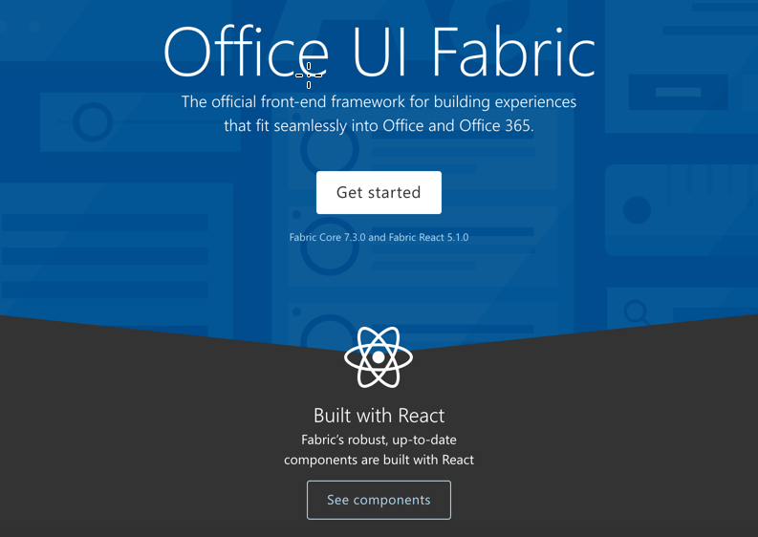
Building add-ins with Angular – Office UI Fabric
Office UI Fabric React
Includes 40+ robust and up-to-date components built with the React framework
Cannot be directly integrated into Angular, but you can wrap Fabric components in an Angular component
Angular community built Office UI Fabric directives for AngularJS (http://ngofficeuifabric.com/) but these don’t immediately port over to Angular
Office UI Fabric Core
Includes styles, icons, typography, brand icons, colors, grids, and more.
Notes:
Microsoft has clearly committed React with the Office UI Fabric. However, that doesn’t mean you can’t leverage it in an Angular project. In fact, for AngularJS, the community built a large number of AngularJS directives for the Office UI Fabric. Although these can’t easily be leveraged in Angular and no grassroots effort exists yet to upgrade them, you can wrap the React components in Angular components. There is a sample of this referenced in the additional reading of this deck. You can also easily incorporate the Office UI Fabric Core styles, which provide styles, icons, typography, brand icons, colors, grids and much more!

Slide 9
Side-loading and debugging
Side-loading (All environments)
Start the web host
Ensure your browser will accept the SSL certificate
Create a new Office Online document
Upload the manifest through the insert Office add-in dialog
Side-loading (Win32 Office Client)
Create a local share in the file system
Copy your manifest file to this local share
Open the Win32 Office client
Add the local share to the Trusted Add-in Catalogs in the Trust Center > Trust Center Settings menu
Debugging in Office Online
Leverage the browser developer tools (F12) for debugging
Debugging in Win32 Office from Visual Studio
Open the menu in the top right corner of the task pane
Select Attach Debugger to launch the Visual Studio Just-in-Time Debugger
Notes:
For side loading and debugging Angular add-ins, the approach is the same as React. Office Online is available to all developer environments as involves uploading the add-in xml manifest through a new Office document in Office Online (via OneDrive). Debugging can be done with the browser developer tools.
For Windows users, you can side load the add-in by creating a local network share, placing the add-in xml manifest in that share, and configuring the Office Client to look for add-ins in this location (via the Trusted Add-in Catalog settings of Trust Center). Visual Studio users can even attach a debugger to task pane add-ins running in the Win32 Office client.

Slide 10
Demo
Notes:
In this demo, we will use the Angular CLI and Office Yeoman generator to create and run a new Angular add-in.
1. Open the Demo/Lab markdown for this section in the module
2. Complete the Provision the Office add-in and Side-load the Office add-in steps
3. Update the code in Office.initialize to update the A1 cell of the worksheet:
await Excel.run(async (context) => {
var sheet = context.workbook.worksheets.getActiveWorksheet();
var range = sheet.getRange("A1:A1");
range.values = [["Hello World"]];
await context.sync()
});
4. Run the complete solution located in the Demos/02 Build Add0in using Angular folder
Stop the server on the previous steps
Clone
Run npm install
Run npm run start
Side-load the add-in (or just refresh the one already running as it uses the same port)

Slide 11

Summary
Angular a complete overhaul of AngularJS and better positioned for complex solutions
Angular CLI combined with the Office Yeoman generator is best way to get project started
You must bootstrap Angular in Office.initialize
You can wrap Office UI Fabric components in Angular components or use Office UI Fabric Core

Slide 12
Reading further
Tips for creating Office add-ins with Angular
https://docs.microsoft.com/en-us/office/dev/add-ins/develop/add-ins-with-angular2
Example of wrapping Office UI Fabric React component in Angular component
https://github.com/OfficeDev/Word-Add-in-Angular2-StyleChecker
Convert an Office Add-in task pane template in Visual Studio to TypeScript
https://docs.microsoft.com/en-us/office/dev/add-ins/develop/convert-javascript-to-typescript
Side-loading Office Add-ins for testing
https://docs.microsoft.com/en-us/office/dev/add-ins/testing/create-a-network-shared-folder-catalog-for-task-pane-and-content-add-ins
Side-loading Office Add-ins in Office Online for testing
https://docs.microsoft.com/en-us/office/dev/add-ins/testing/sideload-office-add-ins-for-testing

Slide 13
Thank you

